Slide 1
SGA DO Class of 2026

Slide 2
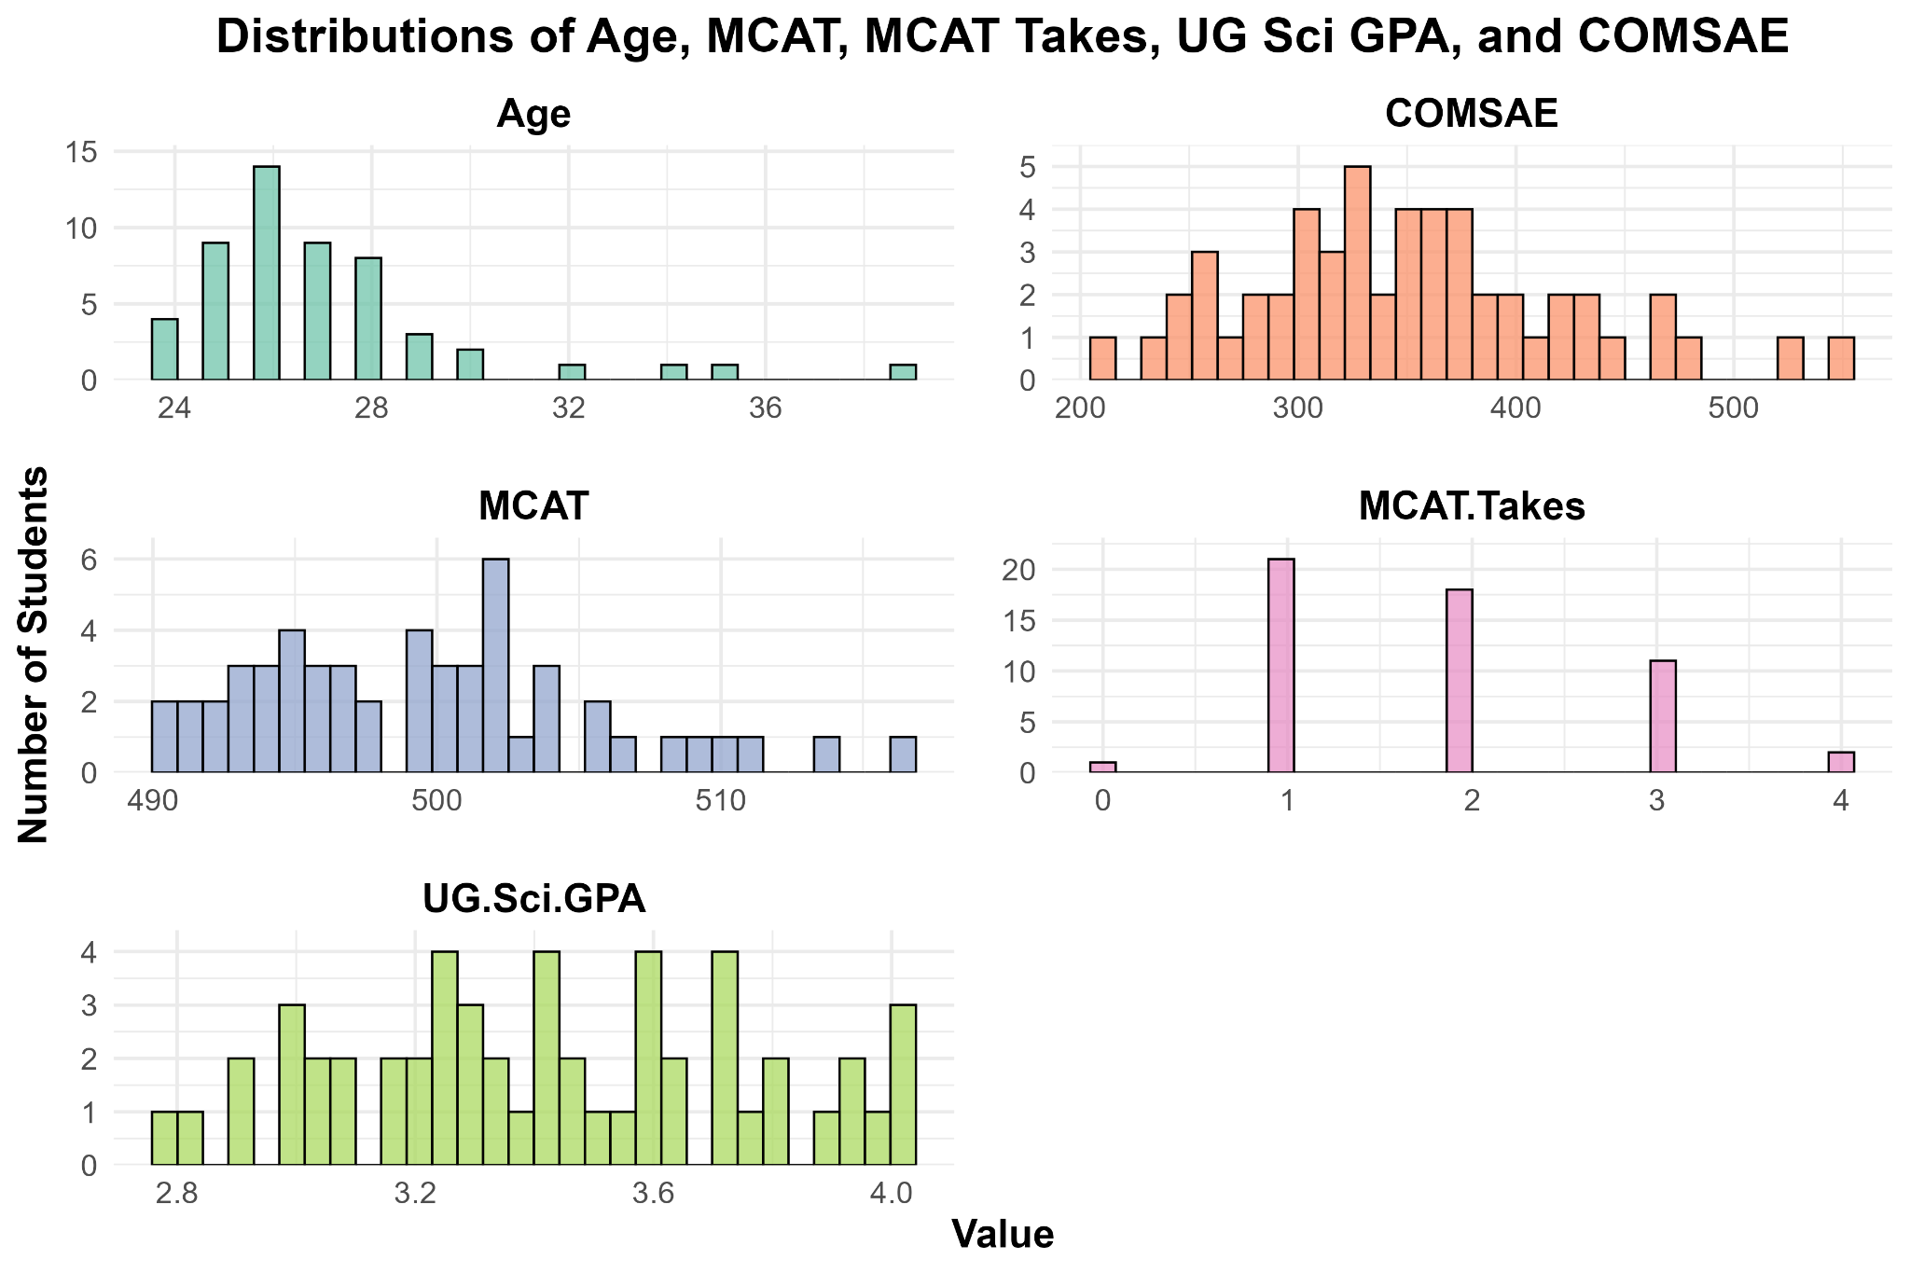
Distribution Overview The histograms display the distributions of Age, MCAT scores, MCAT attempts, Undergraduate Science GPA, and COMSAE scores for the cohort.
MCAT scores and Science GPAs are skewed toward higher values, reflecting strong academic preparation.
Most students attempted the MCAT once or twice.
Age is concentrated around the traditional range, with some older students present.
COMSAE scores show moderate variation across students.
These distributions support the use of these variables in clustering analyses by demonstrating sufficient spread and differentiation.

Slide 3
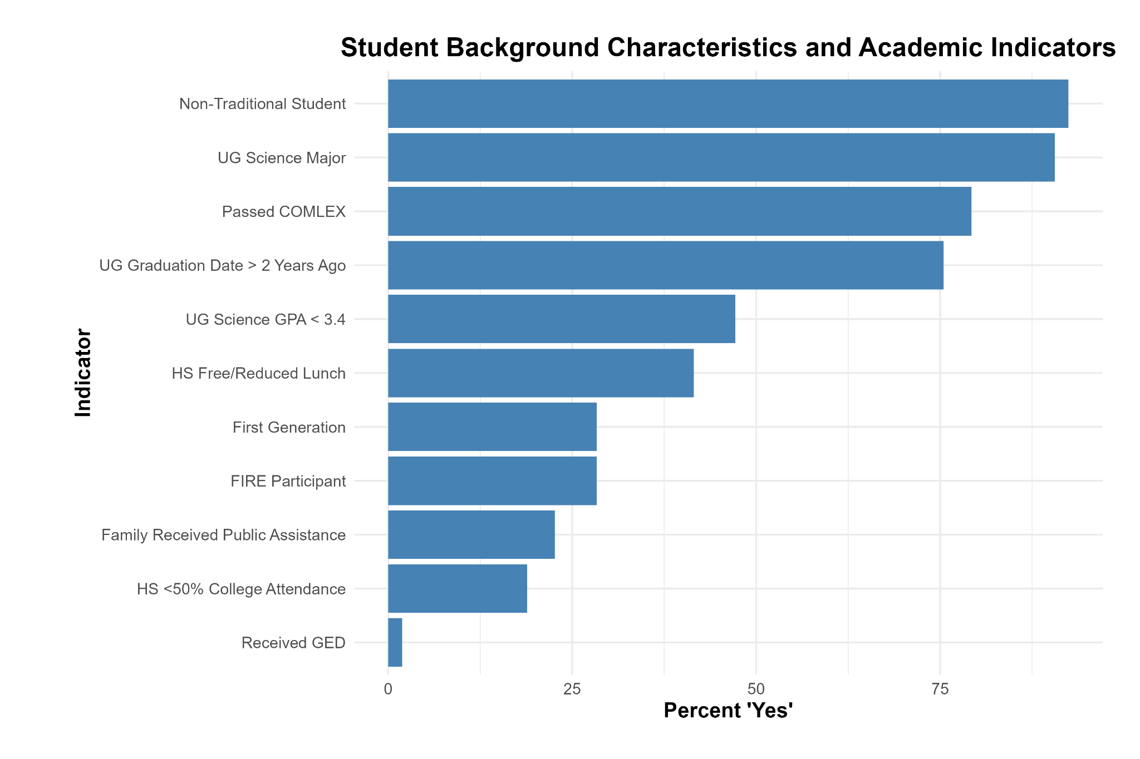
Background Indicators Overview: This chart summarizes the percentage of students who meet selected academic and socioeconomic indicators.
A majority of students successfully passed the COMLEX exam.
A significant portion of the cohort identify as first-generation college students and/or received free or reduced-price lunch in high school.
Rates of students coming from families that received public assistance or attended low-college-going high schools are also notable.
These background factors provide important context for understanding the educational pathways and outcomes of the cohort.

Slide 4
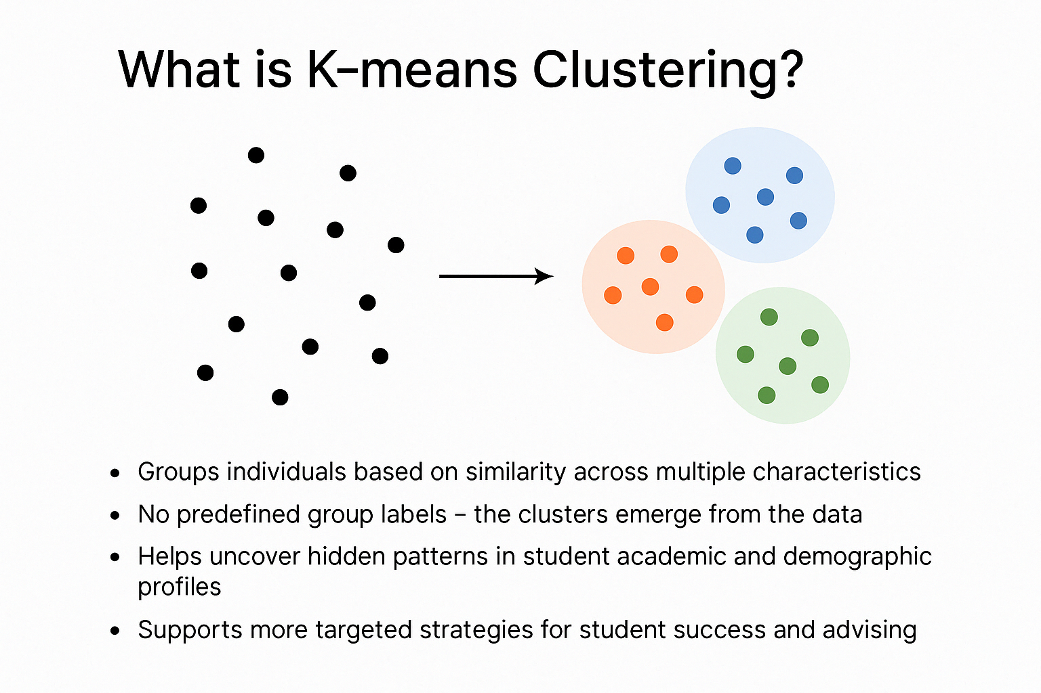

Slide 5

Cohort Averages for Key Academic and Demographic Indicators
The average MCAT score was 502.3, with most students taking the MCAT 1–2 times.
The cohort’s average undergraduate science GPA was 3.42, and the average COMSAE score was 585.4.

Slide 6
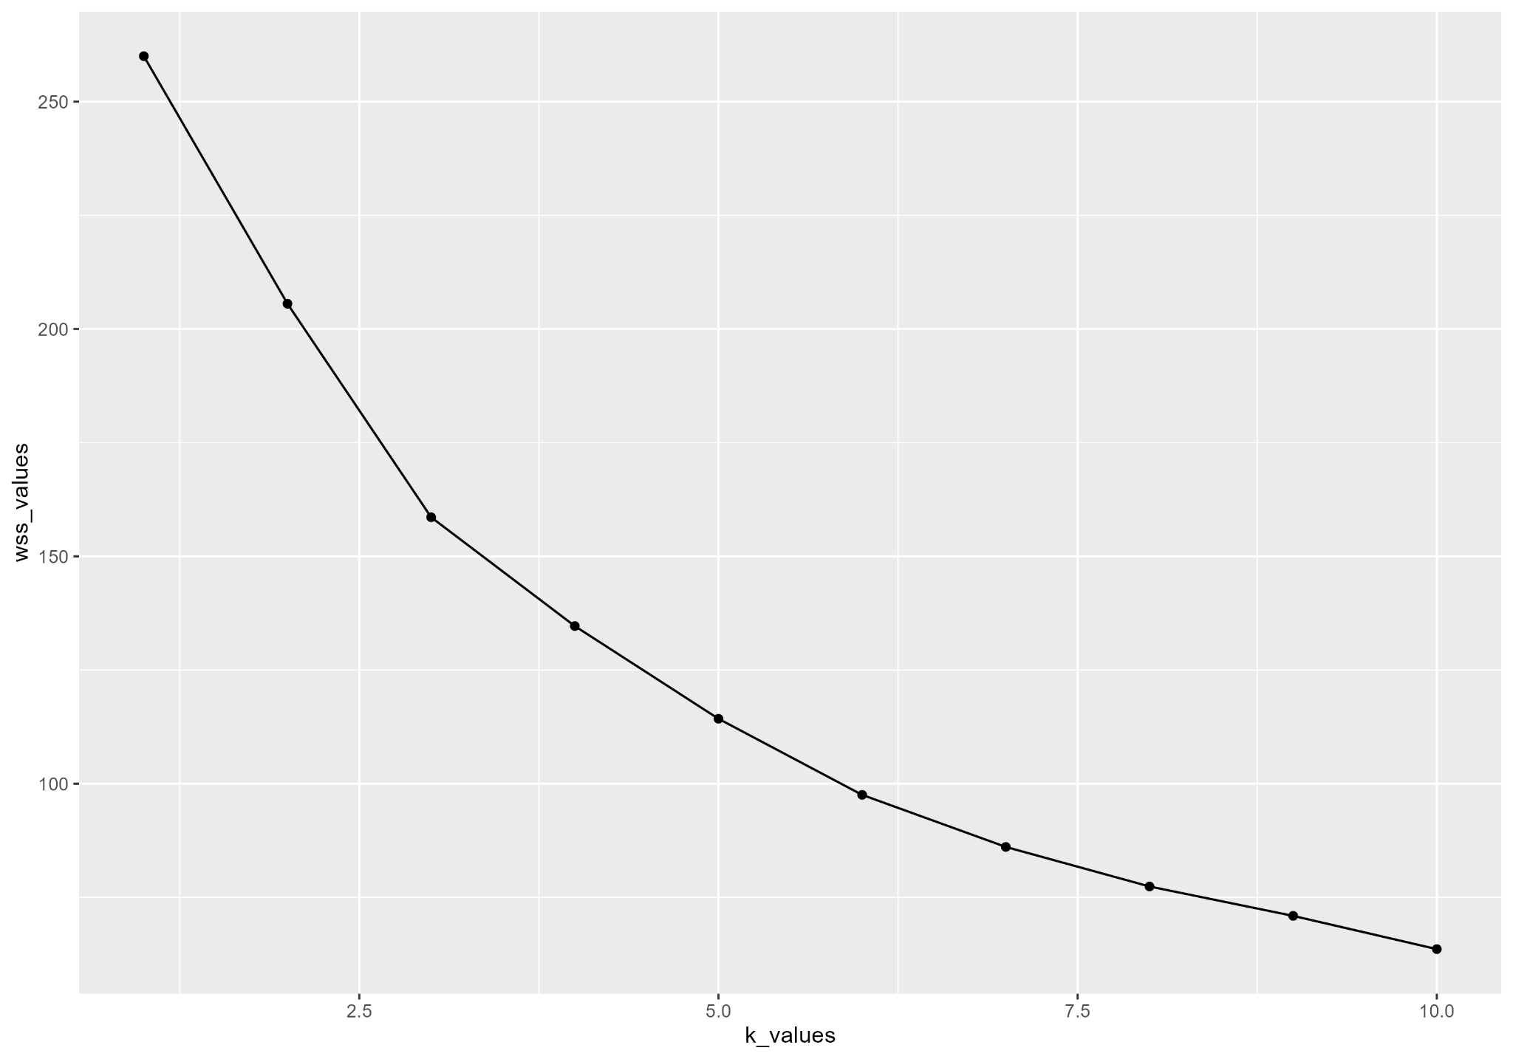
Choosing the Number of Clusters: Elbow Method
Data and Purpose:
This analysis examines student academic and demographic indicators (MCAT, attempts, UG Sci GPA, age, and COMLEX outcomes) using K-means clustering. The goal is to explore whether underlying student profiles are associated with differences in COMSAE performance.
Notes:
We clustered students based on MCAT scores, attempts, undergraduate science GPA, age, and COMLEX outcomes.
The elbow method shows that four clusters provide a good balance — after four, improvements level off.
This supports using four clusters to explore different student profiles."

Slide 7
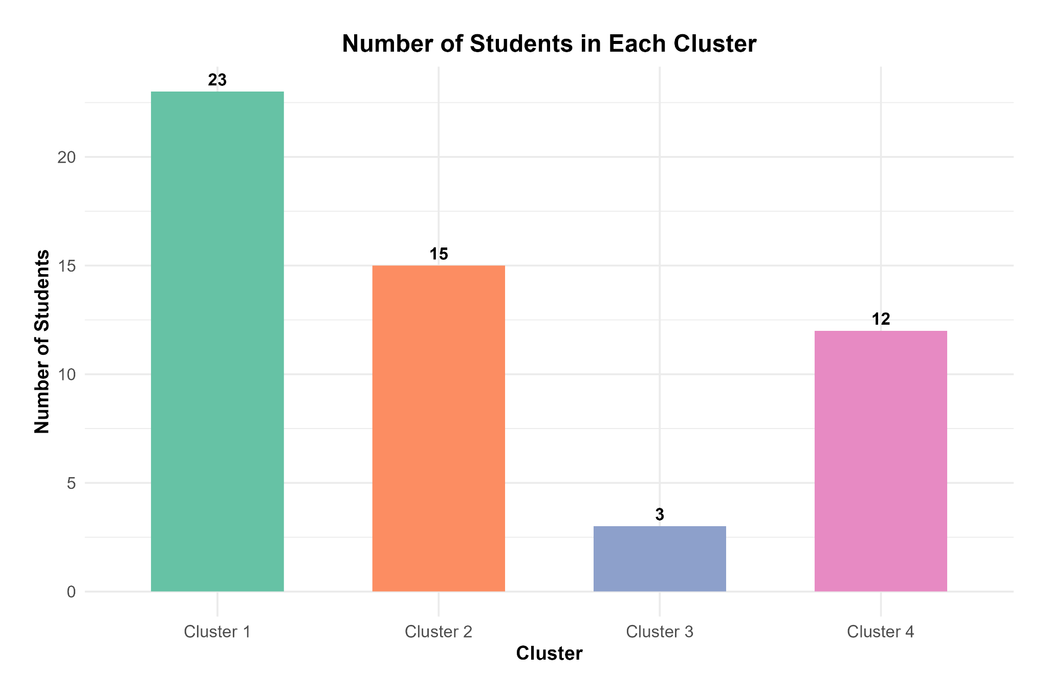

Slide 8
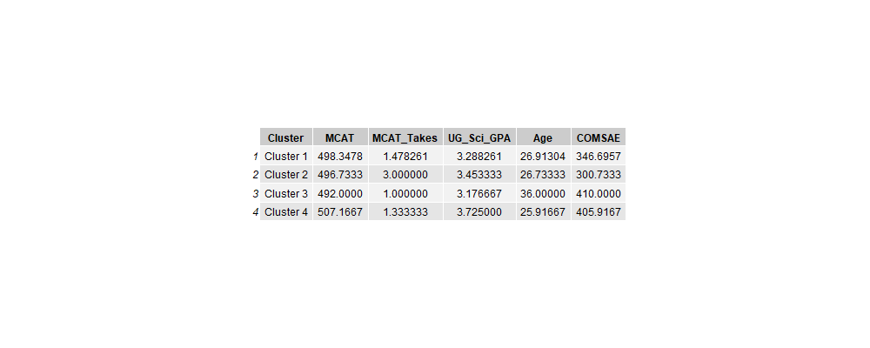
Cluster Profiles
Interpretation:
Cluster 4: Strongest academic profile (highest MCAT and UG Sci GPA; higher COMSAE scores).
Cluster 3: Older students with lower academic indicators (higher Age, lower MCAT, UG Sci GPA).
Cluster 2: Students with more MCAT attempts and lower COMSAE outcomes.
Cluster 1: Near average on most indicators, slightly below average UG Sci GPA.
Variables are normalized (mean = 0, SD = 1). Positive values indicate above-average, negative values indicate below-average relative to the cohort.
Notes:
"Cluster 4 represents students with the strongest academic profile, while Cluster 3 includes older students with slightly lower MCAT and GPA performance but better COMSAE scores. Cluster 2 had the highest number of MCAT attempts, despite a moderate GPA."

Slide 9
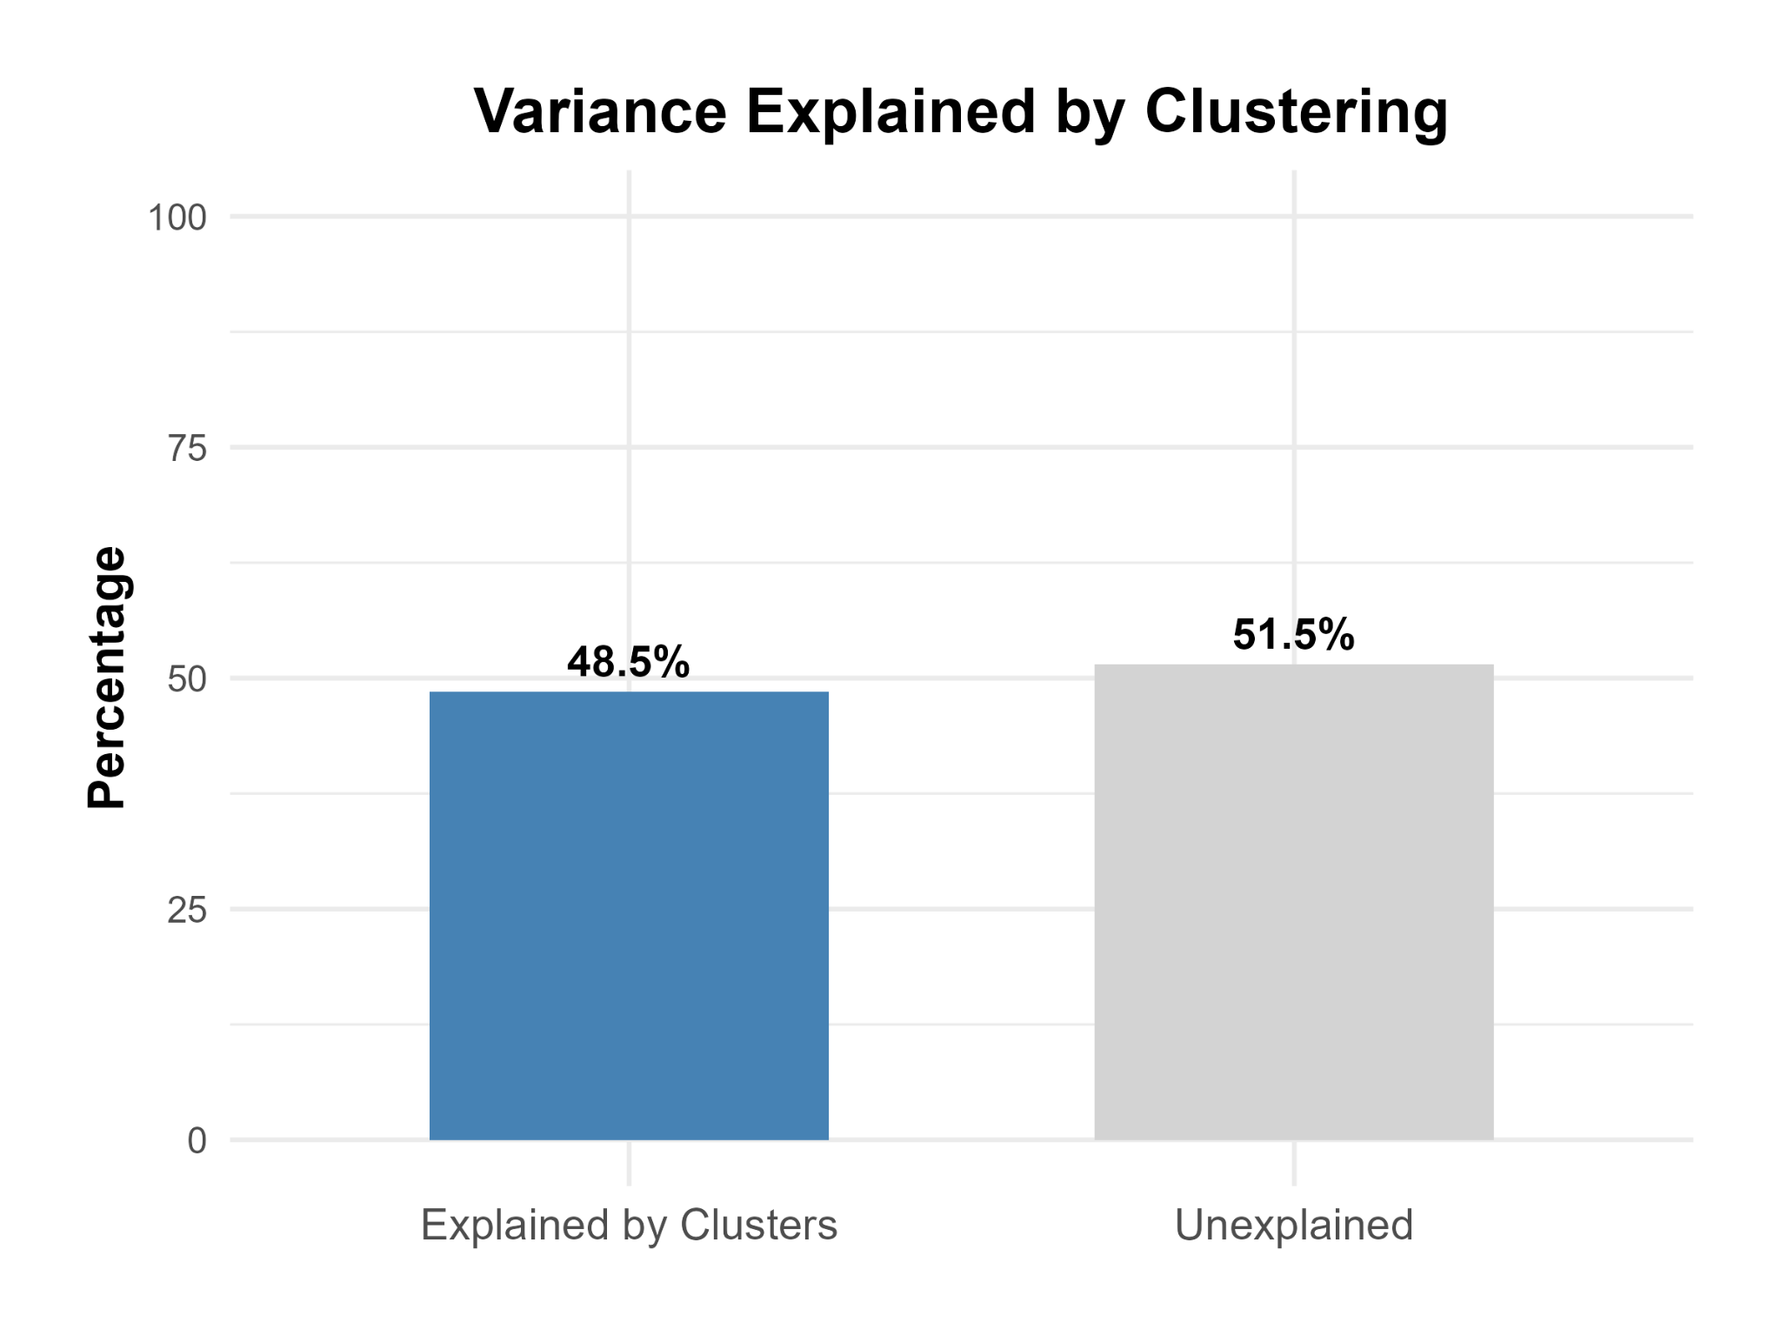
"Our K-means clustering model explains about 48.5% of the total variability across students’ academic and demographic indicators.
This means that nearly half of the variation in MCAT scores, MCAT attempts, undergraduate science GPA, age, and COMSAE performance can be grouped meaningfully into distinct student profiles."

Slide 10
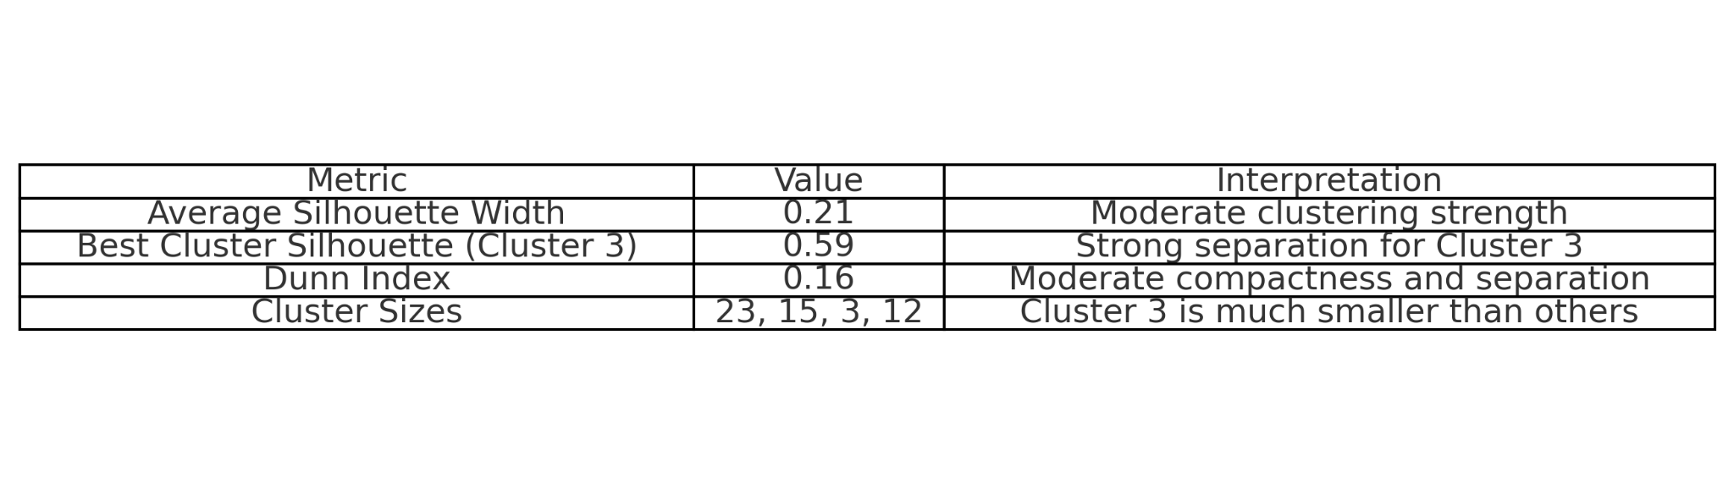
Cluster Quality Summary
Average silhouette width = 0.21, indicating moderate clustering structure.
Cluster 3 has the highest silhouette score (0.59), suggesting better-defined grouping among older students.
Dunn index = 0.16, suggesting clusters are moderately separated relative to their compactness.

Slide 11
Conclusion
Summary of Findings:
Four distinct student profiles were identified based on academic and demographic indicators.
Cluster differences highlight key patterns in MCAT performance, number of attempts, undergraduate Sci GPA, age, and COMSAE outcomes.
Students with stronger MCAT scores and UG Sci GPAs tended to have higher COMSAE performance, while clusters with more MCAT attempts and older age profiles showed varied outcomes.
Key Takeaway: Data-driven clustering can reveal meaningful student groupings, helping to better understand pathways to academic success.

Slide 12
Method: Hierarchical Clustering Using Manhattan Distance
Objective: Group student based on similarities in admissions data to explore patterns related to COMLEX pass/fail outcomes.
Admissions Data Points:
HRSA questions
MCAT <500
UG Sci Major
UG Sci GPA <3.4
Non traditional 25 years or older
Out of UG 2+ years
FIRE Participant
COMLEX
Why Manhattan Distance?
Measures differences across all admissions factors More appropriate than straight-line (Euclidean) distance for categorical or mixed-type data Interpreted like city-block distances — adds up absolute differences

Slide 13
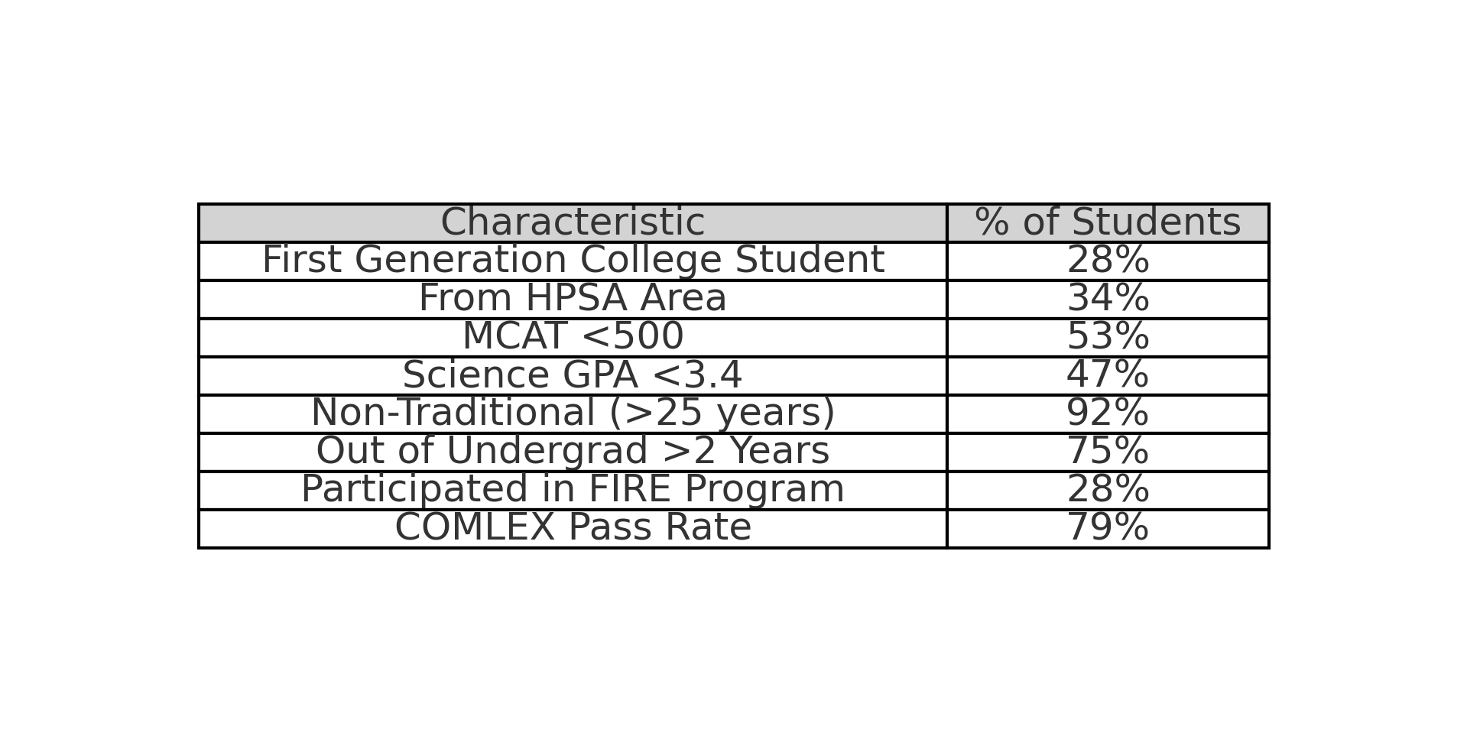
Profile of all Students

Slide 14
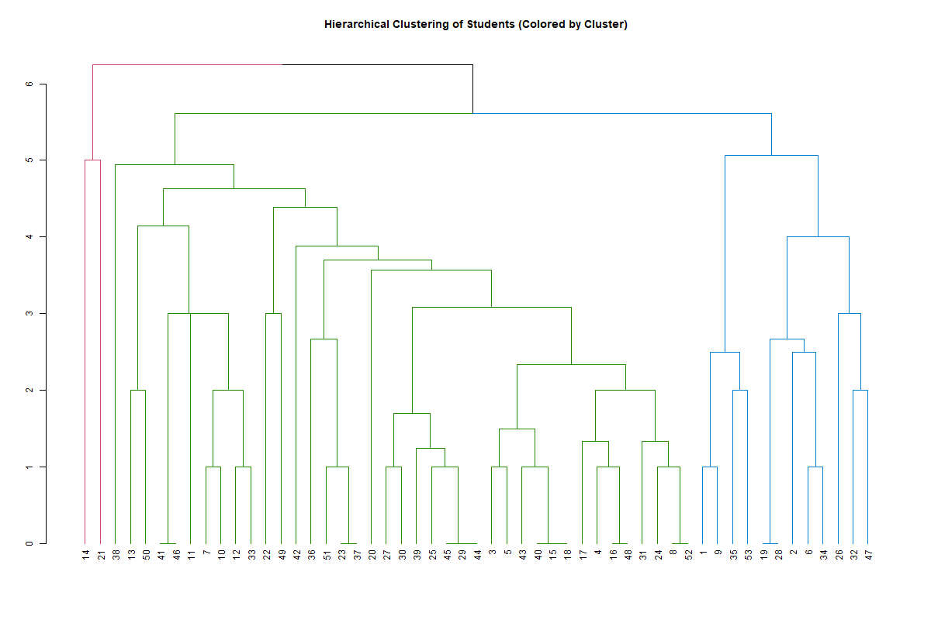
Notes:
Three clusters were chosen because the dendrogram showed a natural split into three distinct groups — providing enough separation to observe meaningful differences without over-fragmenting the data.

Slide 15
Cluster Sizes
Cluster 2: Largest group, 39 students
Cluster 1: Moderate size, 12 students
Cluster 3: Very small, only 2 students (caution: small sample)
Cluster 2 represents the majority of students, while Cluster 1 is a moderate-sized group. Cluster 3 is very small, with only 2 students, so we should interpret any trends within it cautiously.

Slide 16
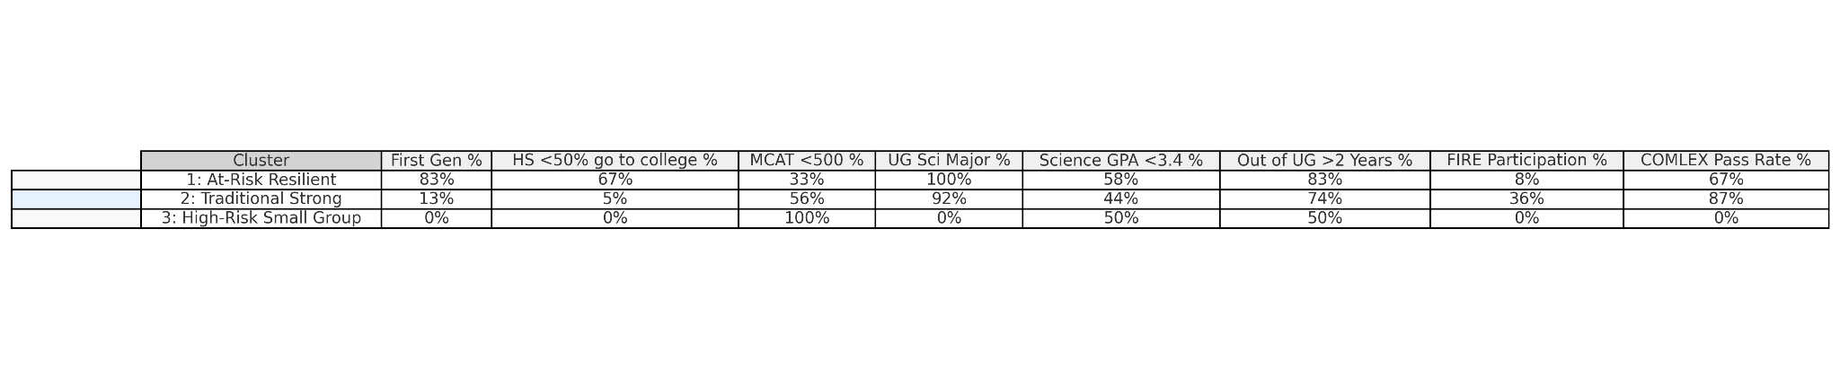
Cluster Profiles
Cluster 1: High educational disadvantage, moderate COMLEX success (67%).
Cluster 2: Stronger academic backgrounds, highest COMLEX success (87%).
Cluster 3: High academic risk factors, poor COMLEX outcomes (0%).

Slide 17
Key Findings
Educational Disadvantage:
Cluster 1 had the highest percentage of first-generation students (83%) and students from low college-attending high schools (67%).
Cluster 2 had very few first-generation students (13%) and minimal educational disadvantage (5%).
Academic Backgrounds:
MCAT <500 was common in Cluster 2 (56%) and universal in Cluster 3 (100%).
Cluster 1 students were all undergraduate science majors (100%), while Cluster 3 had no science majors (0%).
Undergraduate Academic Performance:
Science GPAs below 3.4 were common across all clusters (Cluster 1: 58%, Cluster 2: 44%, Cluster 3: 50%).
FIRE Participation:
Cluster 2 had the highest FIRE program participation (36%), compared to only 8% in Cluster 1 and 0% in Cluster 3.
Non-Traditional Students:
A large majority in Clusters 1 and 2 were out of undergraduate for over two years before starting medical school (83% and 74%).
COMLEX Outcomes:
Cluster 2 achieved the highest COMLEX pass rate (87%).
Cluster 1 had a moderate pass rate (67%), showing resilience despite academic and educational disadvantages.
Cluster 3 had a 0% pass rate, highlighting compounded academic risks (low MCAT, no science major, no FIRE participation).

